Slide 1

3 Goals for Better Code
Sean Parent | Principal Scientist

Slide 2
No Raw Loops

Slide 3
What is a Raw Loop?
A raw loop is any loop inside a function where the function serves purpose larger than the algorithm implemented by the loop

Slide 4
What is a Raw Loop?
void PanelBar::RepositionExpandedPanels(Panel* fixed_panel) {
CHECK(fixed_panel);
// First, find the index of the fixed panel.
int fixed_index = GetPanelIndex(expanded_panels_, *fixed_panel);
CHECK_LT(fixed_index, expanded_panels_.size());
// Next, check if the panel has moved to the other side of another panel.
const int center_x = fixed_panel->cur_panel_center();
for (size_t i = 0; i < expanded_panels_.size(); ++i) {
Panel* panel = expanded_panels_[i].get();
if (center_x <= panel->cur_panel_center() ||
i == expanded_panels_.size() - 1) {
if (panel != fixed_panel) {
// If it has, then we reorder the panels.
ref_ptr<Panel> ref = expanded_panels_[fixed_index];
expanded_panels_.erase(expanded_panels_.begin() + fixed_index);
if (i < expanded_panels_.size()) {
expanded_panels_.insert(expanded_panels_.begin() + i, ref);
} else {
expanded_panels_.push_back(ref);
}
}
break;
}
}
// Find the total width of the panels to the left of the fixed panel.
int total_width = 0;
fixed_index = -1;
for (int i = 0; i < static_cast<int>(expanded_panels_.size()); ++i) {
Panel* panel = expanded_panels_[i].get();
if (panel == fixed_panel) {
fixed_index = i;
break;
}
total_width += panel->panel_width();
}
CHECK_NE(fixed_index, -1);
int new_fixed_index = fixed_index;
// Move panels over to the right of the fixed panel until all of the ones
// on the left will fit.
int avail_width = max(fixed_panel->cur_panel_left() - kBarPadding, 0);
while (total_width > avail_width) {
new_fixed_index--;
CHECK_GE(new_fixed_index, 0);
total_width -= expanded_panels_[new_fixed_index]->panel_width();
}
// Reorder the fixed panel if its index changed.
if (new_fixed_index != fixed_index) {
Panels::iterator it = expanded_panels_.begin() + fixed_index;
ref_ptr<Panel> ref = *it;
expanded_panels_.erase(it);
expanded_panels_.insert(expanded_panels_.begin() + new_fixed_index, ref);
fixed_index = new_fixed_index;
}
// Now find the width of the panels to the right, and move them to the
// left as needed.
total_width = 0;
for (Panels::iterator it = expanded_panels_.begin() + fixed_index + 1;
it != expanded_panels_.end(); ++it) {
total_width += (*it)->panel_width();
}
avail_width = max(wm_->width() - (fixed_panel->cur_right() + kBarPadding),
0);
while (total_width > avail_width) {
new_fixed_index++;
CHECK_LT(new_fixed_index, expanded_panels_.size());
total_width -= expanded_panels_[new_fixed_index]->panel_width();
}
// Do the reordering again.
if (new_fixed_index != fixed_index) {
Panels::iterator it = expanded_panels_.begin() + fixed_index;
ref_ptr<Panel> ref = *it;
expanded_panels_.erase(it);
expanded_panels_.insert(expanded_panels_.begin() + new_fixed_index, ref);
fixed_index = new_fixed_index;
}
// Finally, push panels to the left and the right so they don't overlap.
int boundary = expanded_panels_[fixed_index]->cur_panel_left() - kBarPadding;
for (Panels::reverse_iterator it =
// Start at the panel to the left of 'new_fixed_index'.
expanded_panels_.rbegin() +
(expanded_panels_.size() - new_fixed_index);
it != expanded_panels_.rend(); ++it) {
Panel* panel = it->get();
if (panel->cur_right() > boundary) {
panel->Move(boundary, kAnimMs);
} else if (panel->cur_panel_left() < 0) {
panel->Move(min(boundary, panel->panel_width() + kBarPadding), kAnimMs);
}
boundary = panel->cur_panel_left() - kBarPadding;
}
boundary = expanded_panels_[fixed_index]->cur_right() + kBarPadding;
for (Panels::iterator it = expanded_panels_.begin() + new_fixed_index + 1;
it != expanded_panels_.end(); ++it) {
Panel* panel = it->get();
if (panel->cur_panel_left() < boundary) {
panel->Move(boundary + panel->panel_width(), kAnimMs);
} else if (panel->cur_right() > wm_->width()) {
panel->Move(max(boundary + panel->panel_width(),
wm_->width() - kBarPadding),
kAnimMs);
}
boundary = panel->cur_right() + kBarPadding;
}
}
Notes:
Single function from Chromium OS
First code I reviewed at Google
Not picking on Google (or anyone)- I’ve certainly written code like this
* What are the post conditions of this loop?

Slide 5
Why No Raw Loops?
Difficult to reason about and difficult to prove post conditions
Error prone and likely to fail under non-obvious conditions
Introduce non-obvious performance problems
Complicates reasoning about the surrounding code

Slide 6

Alternatives to Raw Loops
Use an existing algorithm
Prefer standard algorithms if available
Implement a known algorithm as a general function
Contribute it to a library
Preferably open source
Invent a new algorithm
Write a paper
Give talks
Become famous!
Notes:
The standard algorithms have all been proven correct

Slide 7
No Raw Loops
If you want to improve the code quality in your organization, replace all of your coding guidelines with one goal:
No Raw Loops

Slide 8
Two Beautiful Examples

Slide 9
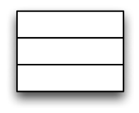



No Raw Loops

Slide 10
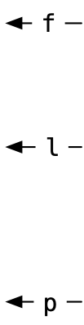
No Raw Loops
rotate(f, l, p);

Slide 11
No Raw Loops

Slide 12
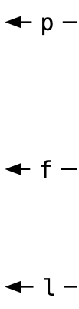
No Raw Loops
rotate(p, f, l);

Slide 13
No Raw Loops
if (p < f) rotate(p, f, l);
if (l < p) rotate(f, l, p);

Slide 14
No Raw Loops
if (p < f) rotate(p, f, l);
if (l < p) rotate(f, l, p);

Slide 15
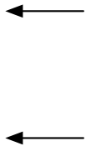
No Raw Loops
if (p < f) rotate(p, f, l);
if (l < p) rotate(f, l, p);

Slide 16
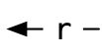
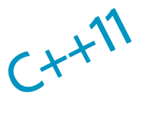
No Raw Loops
if (p < f) return { p, rotate(p, f, l) };
if (l < p) return { rotate(f, l, p), p };

Slide 17
No Raw Loops
if (p < f) return { p, rotate(p, f, l) };
if (l < p) return { rotate(f, l, p), p };
return { f, l };

Slide 18
No Raw Loops
template <typename I> // I models RandomAccessIterator
auto slide(I f, I l, I p) -> pair<I, I>
{
if (p < f) return { p, rotate(p, f, l) };
if (l < p) return { rotate(f, l, p), p };
return { f, l };
}
Notes:
[Add a slide after this showing slide(f, l, p)...]

Slide 19
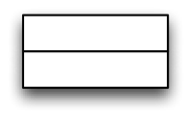
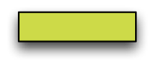

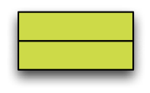

No Raw Loops

Slide 20
No Raw Loops

Slide 21
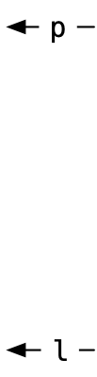
No Raw Loops
stable_partition(p, l, s)

Slide 22
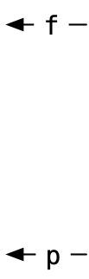
No Raw Loops
stable_partition(f, p, not1(s))

Slide 23
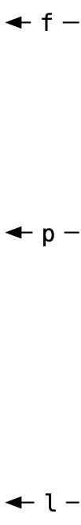
No Raw Loops
stable_partition(f, p, not1(s))
stable_partition(p, l, s)

Slide 24
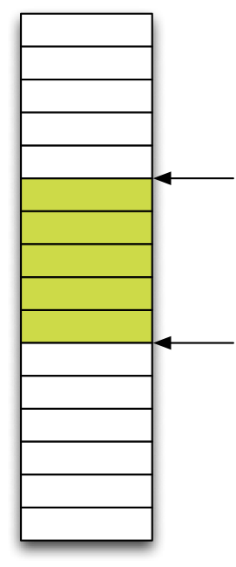
No Raw Loops
stable_partition(f, p, not1(s))
stable_partition(p, l, s)

Slide 25
No Raw Loops
return { stable_partition(f, p, not1(s)),
stable_partition(p, l, s) };

Slide 26
No Raw Loops
template <typename I, // I models BidirectionalIterator
typename S> // S models UnaryPredicate
auto gather(I f, I l, I p, S s) -> pair<I, I>
{
return { stable_partition(f, p, not1(s)),
stable_partition(p, l, s) };
}
*

Slide 27
No Raw Loops
template <typename I, // I models BidirectionalIterator
typename S> // S models UnaryPredicate
auto gather(I f, I l, I p, S s) -> pair<I, I>
{
return { stable_partition(f, p, not1(s)),
stable_partition(p, l, s) };
}
*

Slide 28
What about that messy loop?
// Next, check if the panel has moved to the other side of another panel.
for (size_t i = 0; i < expanded_panels_.size(); ++i) {
Panel* panel = expanded_panels_[i].get();
if (center_x <= panel->cur_panel_center() ||
i == expanded_panels_.size() - 1) {
if (panel != fixed_panel) {
// If it has, then we reorder the panels.
ref_ptr<Panel> ref = expanded_panels_[fixed_index];
expanded_panels_.erase(expanded_panels_.begin() + fixed_index);
if (i < expanded_panels_.size()) {
expanded_panels_.insert(expanded_panels_.begin() + i, ref);
} else {
expanded_panels_.push_back(ref);
}
}
break;
}
}

Slide 29
What about that bad loop?
// Next, check if the panel has moved to the other side of another panel.
for (size_t i = 0; i < expanded_panels_.size(); ++i) {
Panel* panel = expanded_panels_[i].get();
if (center_x <= panel->cur_panel_center() ||
i == expanded_panels_.size() - 1) {
if (panel != fixed_panel) {
// If it has, then we reorder the panels.
ref_ptr<Panel> ref = expanded_panels_[fixed_index];
expanded_panels_.erase(expanded_panels_.begin() + fixed_index);
expanded_panels_.insert(expanded_panels_.begin() + i, ref);
}
break;
}
}

Slide 30
What about that bad loop?
// Next, check if the panel has moved to the other side of another panel.
for (size_t i = 0; i < expanded_panels_.size(); ++i) {
Panel* panel = expanded_panels_[i].get();
if (center_x <= panel->cur_panel_center() ||
i == expanded_panels_.size() - 1) {
break;
}
}
// Fix this code - panel is the panel found above.
if (panel != fixed_panel) {
// If it has, then we reorder the panels.
ref_ptr<Panel> ref = expanded_panels_[fixed_index];
expanded_panels_.erase(expanded_panels_.begin() + fixed_index);
expanded_panels_.insert(expanded_panels_.begin() + i, ref);
}
Notes:
This is redundant - we are looking for an element that we _know_ is in the list.

Slide 31
What about that bad loop?
// Next, check if the panel has moved to the other side of another panel.
for (size_t i = 0; i < expanded_panels_.size(); ++i) {
Panel* panel = expanded_panels_[i].get();
if (center_x <= panel->cur_panel_center()) break;
}
// Fix this code - panel is the panel found above.
if (panel != fixed_panel) {
// If it has, then we reorder the panels.
ref_ptr<Panel> ref = expanded_panels_[fixed_index];
expanded_panels_.erase(expanded_panels_.begin() + fixed_index);
expanded_panels_.insert(expanded_panels_.begin() + i, ref);
}
Notes:
This is find_if()

Slide 32
What about that bad loop?
// Next, check if the panel has moved to the other side of another panel.
auto p = find_if(begin(expanded_panels_), end(expanded_panels_),
[&](const ref_ptr<Panel>& e){ return center_x <= e->cur_panel_center(); });
// Fix this code - panel is the panel found above.
if (panel != fixed_panel) {
// If it has, then we reorder the panels.
ref_ptr<Panel> ref = expanded_panels_[fixed_index];
expanded_panels_.erase(expanded_panels_.begin() + fixed_index);
expanded_panels_.insert(expanded_panels_.begin() + i, ref);
}
Notes:
This is find_if()

Slide 33
What about that bad loop?
// Next, check if the panel has moved to the other side of another panel.
auto p = find_if(begin(expanded_panels_), end(expanded_panels_),
[&](const ref_ptr<Panel>& e){ return center_x <= e->cur_panel_center(); });
// Fix this code - panel is the panel found above.
if (panel != fixed_panel) {
// If it has, then we reorder the panels.
auto f = begin(expanded_panels_) + fixed_index;
rotate(p, f, f + 1);
}
Notes:
We don’t need this check - we can rotate an empty range!

Slide 34
What about that bad loop?
// Next, check if the panel has moved to the other side of another panel.
auto p = find_if(begin(expanded_panels_), end(expanded_panels_),
[&](const ref_ptr<Panel>& e){ return center_x <= e->cur_panel_center(); });
// If it has, then we reorder the panels.
auto f = begin(expanded_panels_) + fixed_index;
rotate(p, f, f + 1);
Notes:
We don’t need this check - we can rotate an empty range!

Slide 35
What about that bad loop?
// Next, check if the panel has moved to the left side of another panel.
auto p = find_if(begin(expanded_panels_), end(expanded_panels_),
[&](const ref_ptr<Panel>& e){ return center_x <= e->cur_panel_center(); });
// If it has, then we reorder the panels.
auto f = begin(expanded_panels_) + fixed_index;
rotate(p, f, f + 1);
Notes:
We don’t need this check - we can rotate an empty range!

Slide 36
What about that bad loop?
// Next, check if the panel has moved to the left side of another panel.
auto f = begin(expanded_panels_) + fixed_index;
auto p = lower_bound(begin(expanded_panels_), f, center_x,
[](const ref_ptr<Panel>& e, int x){ return e->cur_panel_center() < x; });
// If it has, then we reorder the panels.
rotate(p, f, f + 1);
This is 1/2 of a slide() that only supports a single element being selected
The other rotate() is the erase()/insert() further down in the function
None of the special cases were necessary
This code is considerably more efficient
Now we can have the conversation about supporting multiple selections and disjoint selections!

Slide 37
Seasoning
Use a range library (Boost or ASL)
auto p = find(begin(a), end(a), x);
auto p = find(a, x);
Have many variants of simple, common algorithms such as find() and copy()
Look for interface symmetry
sort(a, [](const employee& x, const employee& y){ return x.last < y.last; });
auto p = lower_bound(a, "Parent", [](const employee& x, const string& y){ return x.last < y; });
sort(a, less(), &employee::last);
auto p = lower_bound(a, "Parent", less(), &employee::last);

Slide 38
Seasoning
Range based for loops for for-each and simple transforms
for (const auto& e: r) f(e);
for (auto& e: r) e = f(e);
Use const auto& for for-each and auto& for transforms
Keep the body short
A general guideline is no longer than composition of two functions with an operator
for (const auto& e: r) f(g(e));
for (const auto& e: r) { f(e); g(e); };
for (auto& e: r) e = f(e) + g(e);
If the body is longer, factor it out and give it a name

Slide 39
Seasoning
Use lambdas for predicates, comparisons, and projections, but keep them short
Use function objects with template member function to simulate polymorphic lambda
struct last_name {
using result_type = const string&;
template <typename T>
const string& operator()(const T& x) const { return x.last; }
};
// ...
auto p = lower_bound(a, "Parent", less(), last_name());

Slide 40
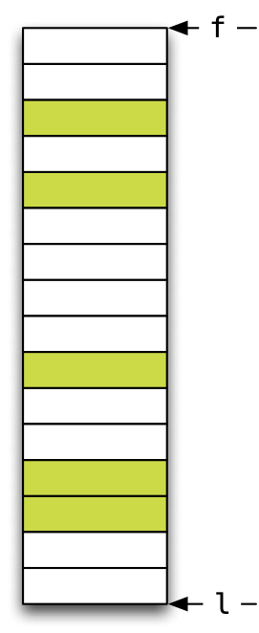
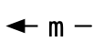
Stable Partition
Back

Slide 41
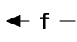

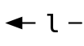
Stable Partition
stable_partition(f, m, p)
stable_partition(m, l, p)
Back

Slide 42


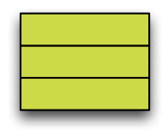
Stable Partition
rotate(stable_partition(f, m, p),
m,
stable_partition(m, l, p));
stable_partition(f, m, p)
stable_partition(m, l, p)
Back

Slide 43
Stable Partition
rotate(stable_partition(f, m, p),
m,
stable_partition(m, l, p));
return rotate(stable_partition(f, m, p),
m,
stable_partition(m, l, p));
template <typename I,
typename P>
auto stable_partition(I f, I l, P p) -> I
{
auto n = l - f;
if (n == 0) return f;
if (n == 1) return f + p(*f);
auto m = f + (n / 2);
return rotate(stable_partition(f, m, p),
m,
stable_partition(m, l, p));
}
Back

Slide 44
No Raw Synchronization Primitives

Slide 45
What are raw synchronization primitives?
Synchronization primitives are basic constructs such as:
Mutex
Atomic
Semaphore
Memory Fence

Slide 46
Why No Raw Synchronization Primitives?
You Will Likely Get It Wrong
Notes:
Emailing Hans Boehm about about how to correctly communicate a bool for cancelation.

Slide 47
Problems with Locks
template <typename T>
class bad_cow {
struct object_t {
explicit object_t(const T& x) : data_m(x) { ++count_m; }
atomic<int> count_m;
T data_m; };
object_t* object_m;
public:
explicit bad_cow(const T& x) : object_m(new object_t(x)) { }
~bad_cow() { if (0 == --object_m->count_m) delete object_m; }
bad_cow(const bad_cow& x) : object_m(x.object_m) { ++object_m->count_m; }
bad_cow& operator=(const T& x) {
if (object_m->count_m == 1) object_m->data_m = x;
else {
object_t* tmp = new object_t(x);
--object_m->count_m;
object_m = tmp;
}
return *this;
}
};
There is a subtle race condition here:
if count != 1 then the bad_cow could also is owned by another thread(s)
if the other thread(s) releases the bad_cow between these two atomic operations
then our count will fall to zero and we will leak the object
Notes:
I marked in red each of the atomic operations
There is a subtle bug in this code...

Slide 48
Problems with Locks
template <typename T>
class bad_cow {
struct object_t {
explicit object_t(const T& x) : data_m(x) { ++count_m; }
atomic<int> count_m;
T data_m; };
object_t* object_m;
public:
explicit bad_cow(const T& x) : object_m(new object_t(x)) { }
~bad_cow() { if (0 == --object_m->count_m) delete object_m; }
bad_cow(const bad_cow& x) : object_m(x.object_m) { ++object_m->count_m; }
bad_cow& operator=(const T& x) {
if (object_m->count_m == 1) object_m->data_m = x;
else {
object_t* tmp = new object_t(x);
if (0 == --object_m->count_m) delete object_m;
object_m = tmp;
}
return *this;
}
};
Notes:
I marked in red each of the atomic operations
There is a subtle bug in this code...

Slide 49
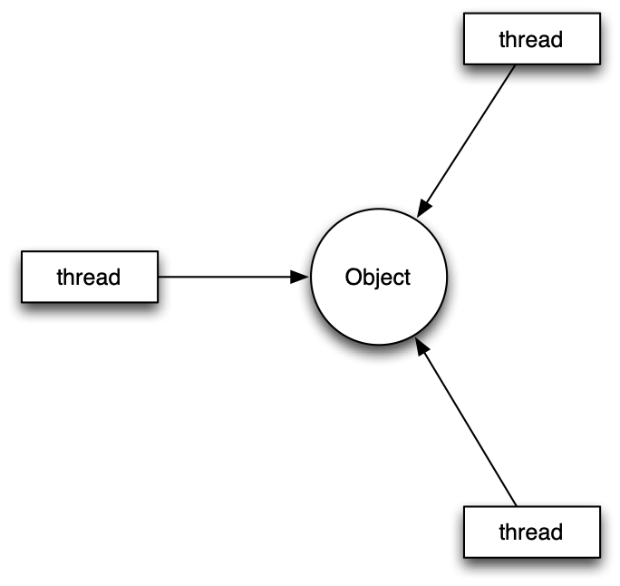

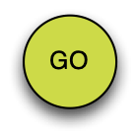

Why No Raw Synchronization Primitives?

Slide 50
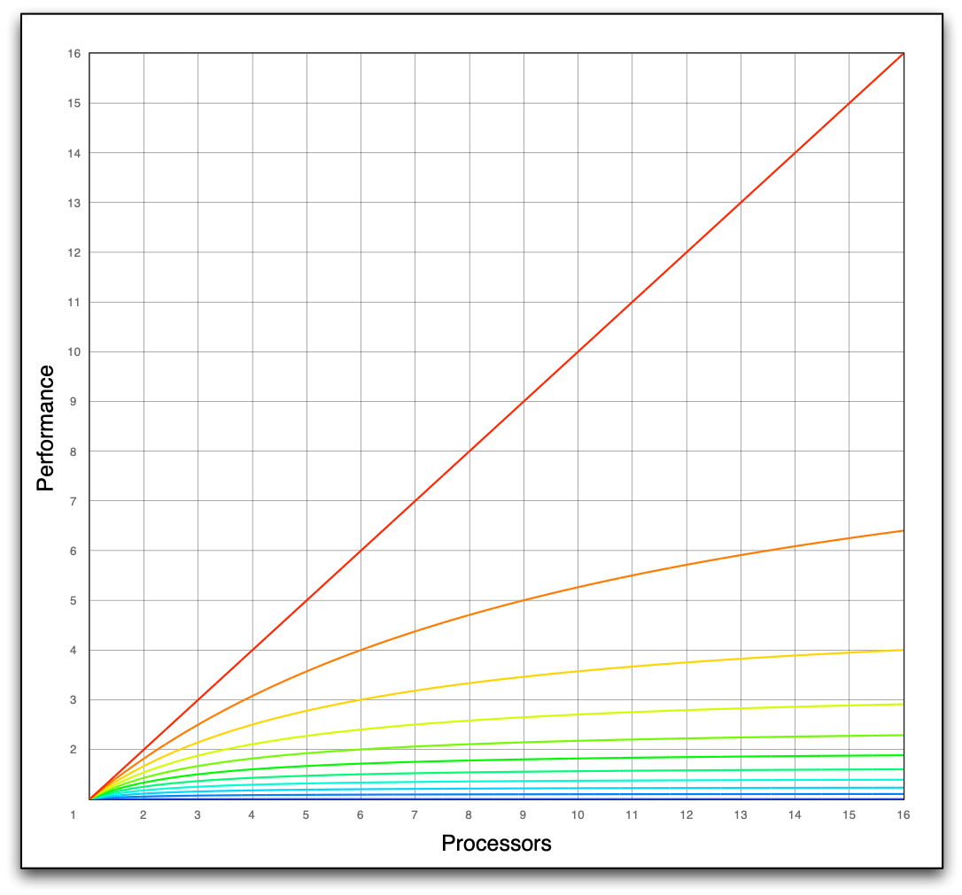
Amdahl’s Law
Notes:
Amount of synchronization - any shared resource causes synchronization

Slide 51
Minimize Locks

Slide 52
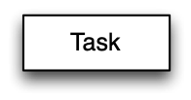
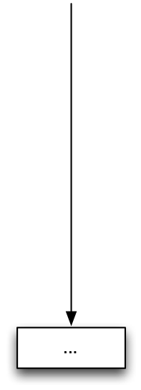

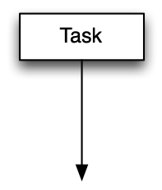
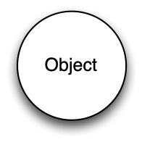
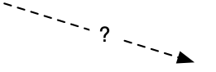
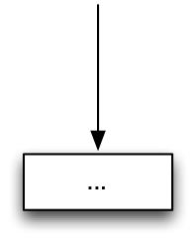
No Raw Synchronization Primitives
Notes:
This is a communicating sequential process model

Slide 53
Tasks
Communicating Sequential Process Model
A task is a unit of work (a function) which is executed asynchronously
Tasks are scheduled on a thread pool to optimize machine utilization
The arguments to the task and the task results are convenient places to communicate with other tasks
Any function can be “packaged” into such a task

Slide 54
Task Systems
Unfortunately, we don’t yet have a standard async task model
std::async() is currently defined to be based on threads
This may change in C++14 and Visual C++ 2012 already implements std::async() as a task model
Windows - Window Thread Pool and PPL
Apple - Grand Central Dispatch (libdispatch)
Open sourced, runs on Linux and Android
Intel TBB - many platform

Slide 55
C++14 compatible async with libdispatch
namespace adobe {
template <typename F, typename ...Args>
auto async(F&& f, Args&&... args)
-> std::future<typename std::result_of<F (Args...)>::type>
{
using result_type = typename std::result_of<F (Args...)>::type;
using packaged_type = std::packaged_task<result_type ()>;
auto p = new packaged_type(std::forward<F>(f), std::forward<Args>(args)...);
auto result = p->get_future();
dispatch_async_f(dispatch_get_global_queue(DISPATCH_QUEUE_PRIORITY_DEFAULT, 0),
p, [](void* f_) {
packaged_type* f = static_cast<packaged_type*>(f_);
(*f)();
delete f;
});
return result;
}
} // namespace adobe

Slide 56
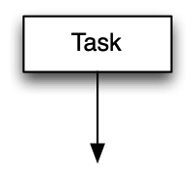
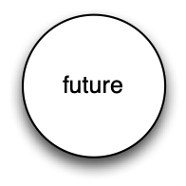
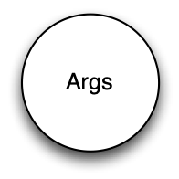
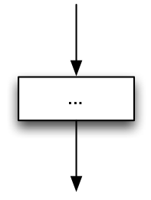
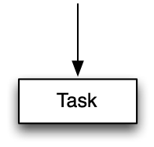

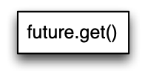
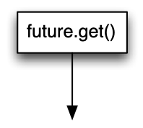

No Raw Synchronization Primitives
Notes:
This is a communicating sequential process model

Slide 57
Task Systems
Blocking on std::future.get() has two problems
One thread resource is consumed, increasing contention
Any subsequent non-dependent calculations on the task are also blocked
Unfortunately, C++11 doesn’t have dependent tasks
GCD has serialized queues and groups
PPL has chained tasks
TBB has flow graphs
All are able to specify dependent tasks, including joins

Slide 58
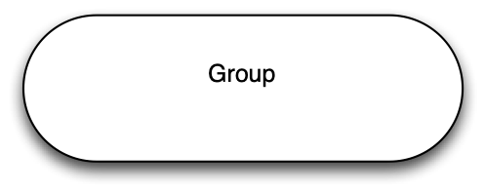
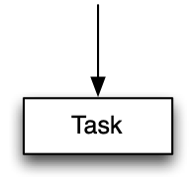
Task Systems
*
Notes:
Add seasoning slide with packaged task
LIttle discussion on other items are too complex.

Slide 59
Seasoning
std::list can be used in a pinch to create thread safe data structures with splice
template <typename T>
class concurrent_queue
{
mutex mutex_;
list<T> q_;
public:
void enqueue(T x)
{
list<T> tmp;
tmp.push_back(move(x));
{
lock_guard<mutex> lock(mutex_);
q_.splice(end(q_), tmp);
}
}
// ...
};

Slide 60
Seasoning
std::packaged_task can be used to marshall results, including exceptions, from tasks
std::packaged_task is also useful to safely bridge C++ code with exceptions to C code
see prior async() implementation for an example

Slide 61
No Raw Pointers

Slide 62
What is a Raw Pointer?
A pointer to an object with implied ownership and reference semantics
T* p = new T
unique_ptr<T>
shared_ptr<T>

Slide 63
Why pointers (heap allocations)?
Runtime variable size
Runtime polymorphic
Container
Satisfy complexity or stability requirements within a container (list vs. vector)
Shared storage for asynchronous communication (future, message queue, …)
Optimization to copy
Copy deferral (copy-on-write)
Immutable item
Elide copy to move
To separate implementation from interface (PIMPL)

Slide 64
Why Pointers
For containers we’ve moved from intrusive to non-intrusive (STL) containers
Except for hierarchies - but containment hierarchies or non-intrusive hierarchies are both viable options
PIMPL and copy optimizations are trivially wrapped
See previous section regarding shared storage for asynchronous operations
Runtime polymorphism

Slide 65
using object_t = int;
void draw(const object_t& x, ostream& out, size_t position)
{ out << string(position, ' ') << x << endl; }
using document_t = vector<object_t>;
void draw(const document_t& x, ostream& out, size_t position)
{
out << string(position, ' ') << "<document>" << endl;
for (const auto& e : x) draw(e, out, position + 2);
out << string(position, ' ') << "</document>" << endl;
}
Notes:
Write a very simple application which consists of a document which contains objects.
Containment is a non-intrusive relationship which relies on particular properties of the objects being placed in the container.

Slide 66
int main()
{
document_t document;
document.emplace_back(0);
document.emplace_back(1);
document.emplace_back(2);
document.emplace_back(3);
draw(document, cout, 0);
}
cout
<document>
0
1
2
3
</document>
Notes:
Not much more difficult to use then "Hello World".

Slide 67
Polymorphism
What happens if we want the document to hold any drawable object?

Slide 68
class object_t {
public:
virtual ~object_t() { }
virtual void draw(ostream&, size_t) const = 0;
};
using document_t = vector<shared_ptr<object_t>>;
void draw(const document_t& x, ostream& out, size_t position)
{
out << string(position, ' ') << "<document>" << endl;
for (const auto& e : x) e->draw(out, position + 2);
out << string(position, ' ') << "</document>" << endl;
}
Notes:
Write a very simple application which consists of a document which contains objects.
Containment is a non-intrusive relationship which relies on particular properties of the objects being placed in the container.

Slide 69
class my_class_t : public object_t
{
public:
void draw(ostream& out, size_t position) const
{ out << string(position, ' ') << "my_class_t" << endl; }
/* ... */
};
int main()
{
document_t document;
document.emplace_back(new my_class_t());
draw(document, cout, 0);
}
document.emplace_back(new my_class_t());
cout
defects
<document>
my_class_t
</document>
An instance of my_class_t will be allocated first
Then the document will grow to make room
If growing the document throws an exception, the memory from my_class_t is leaked
Notes:
Note memory leak at new...
Why can’t I put an integer into my document?

Slide 70
Deep problem
Changed semantics of copy, assignment, and equality of my document
leads to incidental data structures
thread safety concerns

Slide 71
Semantics & Syntax
We define an operation in terms of the operation’s semantics:
“Assignment is a procedure taking two objects of the same type that makes the first object equal to the second without modifying the second.”
Notes:
(2) The more problematic case is adapting incomplete types.
(3) With an exception or two. These are operations on regular types so it isn’t a coincidence that they are so common.

Slide 72
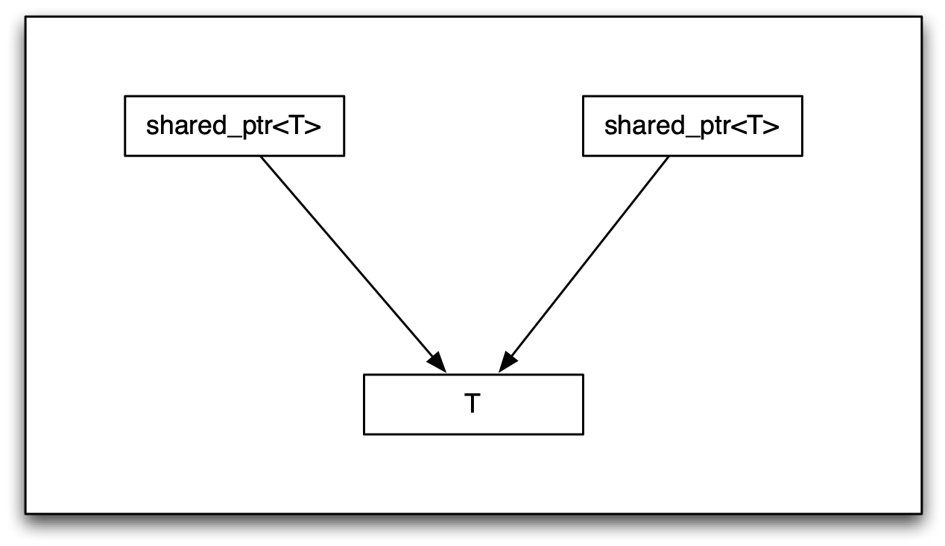
Semantics & Syntax

Slide 73
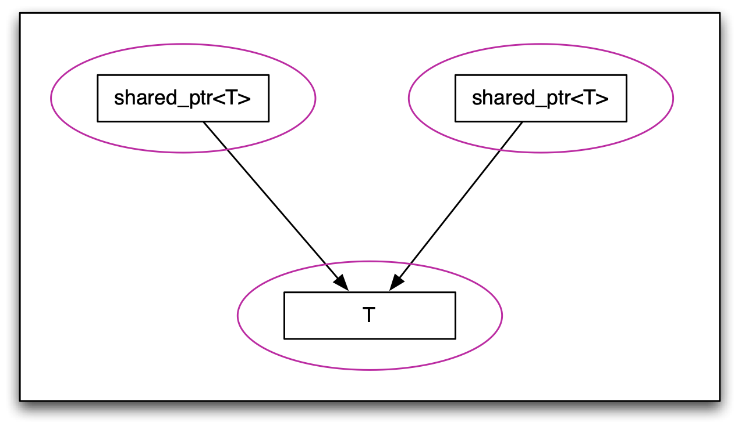
Semantics & Syntax

Slide 74
Semantics & Syntax
Considered as individual types, assignment and copy hold their regular semantic meanings
However, this fails to account for the relationships (the arrows) which form an incidental data-structure. You cannot operate on T through one of the shared pointers without considering the effect on the other shared pointer

Slide 75
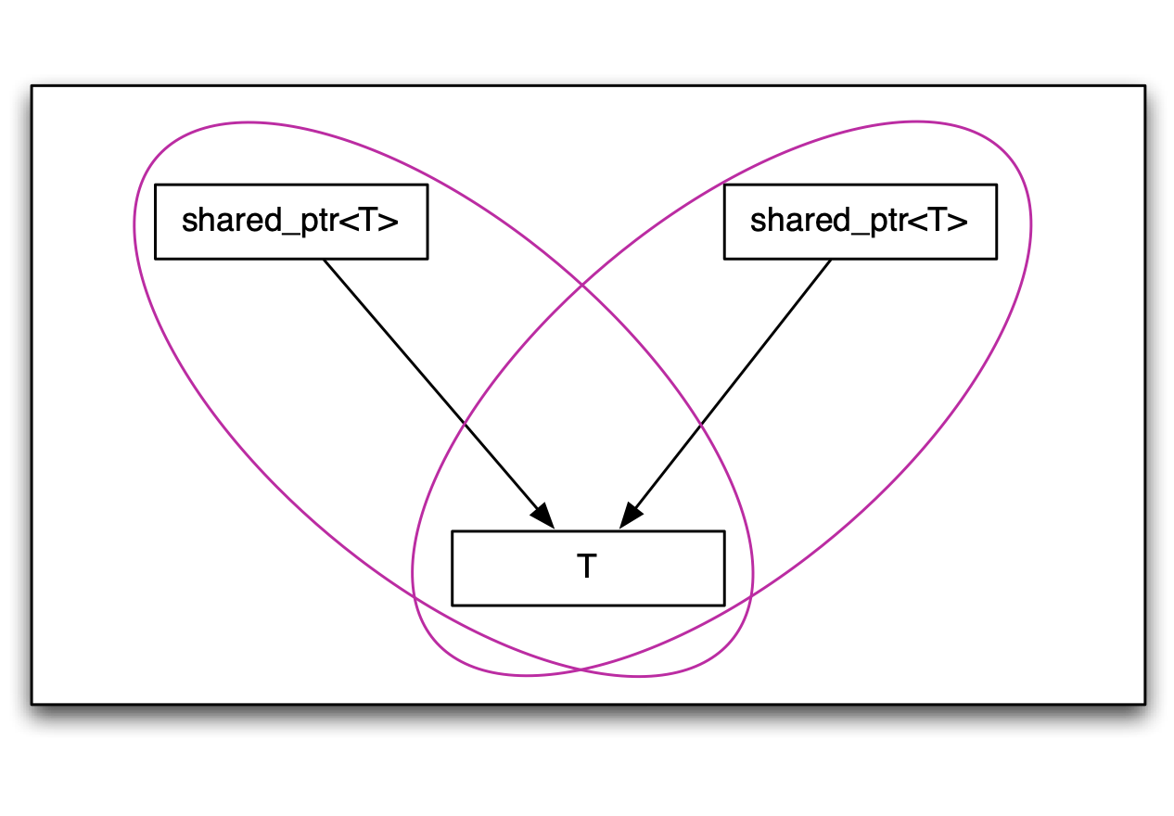
Semantics & Syntax

Slide 76
Semantics & Syntax
If we extend our notion of object type to include the directly related part then we have intersecting objects which will interfere with each other

Slide 77
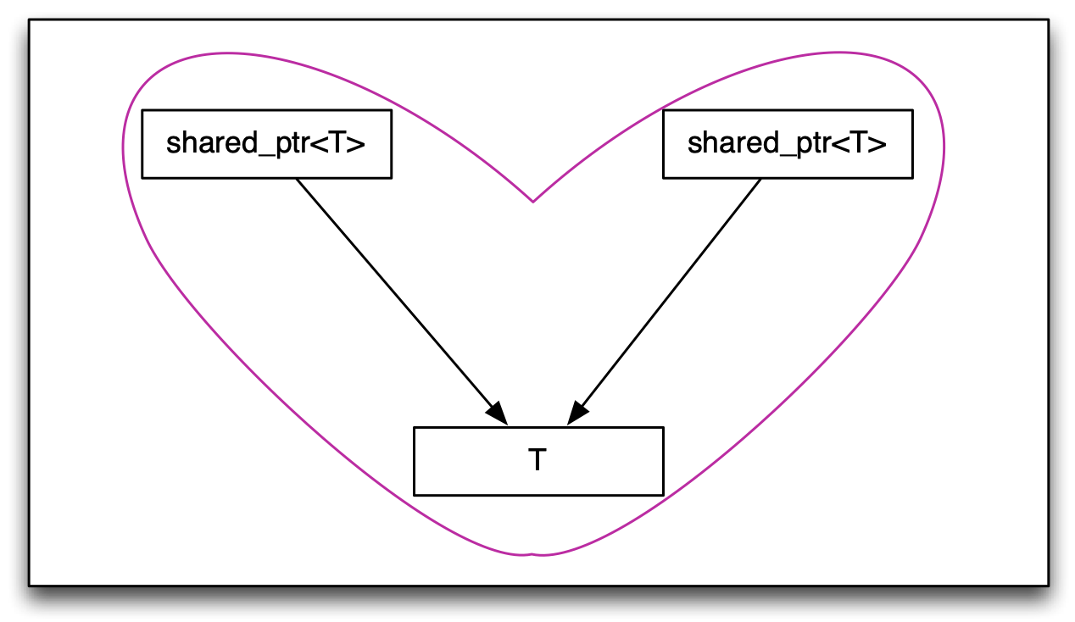
Semantics & Syntax

Slide 78
Semantics & Syntax
When we consider the whole, the standard syntax for copy and assignment no longer have their regular semantics.
This structure is still copyable and assignable but these operations must be done through other means
The shared structure also breaks our ability to reason locally about the code
A shared pointer is as good as a global variable

Slide 79
Semantics & Syntax
Choosing the same syntax for the same semantics enables code reuse and avoids combinatoric interfaces
If a type has a proper set of basis operations then it can be adapted to any alternative set of basis operations regardless of syntax
C++ has defined semantics for operations on built-in types, including assignment, copy, equality, address-of
Using the same operator names to provide the same semantics on user types enables code reuse
Notes:
(2) The more problematic case is adapting incomplete types.
(3) With an exception or two. These are operations on regular types so it isn’t a coincidence that they are so common.

Slide 80
Regular Types
“There is a set of procedures whose inclusion in the computational basis of a type lets us place objects in data structures and use algorithms to copy objects from one data structure to another. We call types having such a basis regular, since their use guarantees regularity of behavior and, therefore, interoperability.”
– Elements of Programming, Section 1.5
Notes:
Add slide about locality of reasoning.

Slide 81
Semantics & Syntax
Regular types where the regular operations are implemented with the standard names are said to have value semantics
When objects are referred to indirectly, through a shared reference or pointer, the objects are said to have reference semantics

Slide 82
template <typename T>
void draw(const T& x, ostream& out, size_t position)
{ out << string(position, ' ') << x << endl; }
class object_t {
public:
template <typename T>
object_t(T x) : self_(make_shared<model<T>>(move(x))) { }
friend void draw(const object_t& x, ostream& out, size_t position)
{ x.self_->draw_(out, position); }
private:
struct concept_t {
virtual ~concept_t() = default;
virtual void draw_(ostream&, size_t) const = 0;
};
template <typename T>
struct model : concept_t {
model(T x) : data_(move(x)) { }
void draw_(ostream& out, size_t position) const
{ draw(data_, out, position); }
T data_;
};
shared_ptr<const concept_t> self_;
};
using document_t = vector<object_t>;
void draw(const document_t& x, ostream& out, size_t position)
{
out << string(position, ' ') << "<document>" << endl;
for (auto& e : x) draw(e, out, position + 2);
out << string(position, ' ') << "</document>" << endl;
}
Notes:
Write a very simple application which consists of a document which contains objects.
Containment is a non-intrusive relationship which relies on particular properties of the objects being placed in the container.

Slide 83
void draw(const T& x, ostream& out, size_t position)
{ out << string(position, ' ') << x << endl; }
class object_t {
public:
template <typename T>
object_t(T x) : self_(make_shared<model<T>>(move(x))) { }
friend void draw(const object_t& x, ostream& out, size_t position)
{ x.self_->draw_(out, position); }
private:
struct concept_t {
virtual ~concept_t() = default;
virtual void draw_(ostream&, size_t) const = 0;
};
template <typename T>
struct model : concept_t {
model(T x) : data_(move(x)) { }
void draw_(ostream& out, size_t position) const
{ draw(data_, out, position); }
T data_;
};
shared_ptr<const concept_t> self_;
};
using document_t = vector<object_t>;
void draw(const document_t& x, ostream& out, size_t position)
{
out << string(position, ' ') << "<document>" << endl;
for (auto& e : x) draw(e, out, position + 2);
out << string(position, ' ') << "</document>" << endl;
}
Notes:
Write a very simple application which consists of a document which contains objects.
Containment is a non-intrusive relationship which relies on particular properties of the objects being placed in the container.

Slide 84
{ out << string(position, ' ') << x << endl; }
class object_t {
public:
template <typename T>
object_t(T x) : self_(make_shared<model<T>>(move(x))) { }
friend void draw(const object_t& x, ostream& out, size_t position)
{ x.self_->draw_(out, position); }
private:
struct concept_t {
virtual ~concept_t() = default;
virtual void draw_(ostream&, size_t) const = 0;
};
template <typename T>
struct model : concept_t {
model(T x) : data_(move(x)) { }
void draw_(ostream& out, size_t position) const
{ draw(data_, out, position); }
T data_;
};
shared_ptr<const concept_t> self_;
};
using document_t = vector<object_t>;
void draw(const document_t& x, ostream& out, size_t position)
{
out << string(position, ' ') << "<document>" << endl;
for (auto& e : x) draw(e, out, position + 2);
out << string(position, ' ') << "</document>" << endl;
}
Notes:
Write a very simple application which consists of a document which contains objects.
Containment is a non-intrusive relationship which relies on particular properties of the objects being placed in the container.

Slide 85
class object_t {
public:
template <typename T>
object_t(T x) : self_(make_shared<model<T>>(move(x))) { }
friend void draw(const object_t& x, ostream& out, size_t position)
{ x.self_->draw_(out, position); }
private:
struct concept_t {
virtual ~concept_t() = default;
virtual void draw_(ostream&, size_t) const = 0;
};
template <typename T>
struct model : concept_t {
model(T x) : data_(move(x)) { }
void draw_(ostream& out, size_t position) const
{ draw(data_, out, position); }
T data_;
};
shared_ptr<const concept_t> self_;
};
using document_t = vector<object_t>;
void draw(const document_t& x, ostream& out, size_t position)
{
out << string(position, ' ') << "<document>" << endl;
for (auto& e : x) draw(e, out, position + 2);
out << string(position, ' ') << "</document>" << endl;
}
Notes:
Write a very simple application which consists of a document which contains objects.
Containment is a non-intrusive relationship which relies on particular properties of the objects being placed in the container.

Slide 86
class object_t {
public:
template <typename T>
object_t(T x) : self_(make_shared<model<T>>(move(x))) { }
friend void draw(const object_t& x, ostream& out, size_t position)
{ x.self_->draw_(out, position); }
private:
struct concept_t {
virtual ~concept_t() = default;
virtual void draw_(ostream&, size_t) const = 0;
};
template <typename T>
struct model : concept_t {
model(T x) : data_(move(x)) { }
void draw_(ostream& out, size_t position) const
{ draw(data_, out, position); }
T data_;
};
shared_ptr<const concept_t> self_;
};
using document_t = vector<object_t>;
void draw(const document_t& x, ostream& out, size_t position)
{
out << string(position, ' ') << "<document>" << endl;
for (auto& e : x) draw(e, out, position + 2);
out << string(position, ' ') << "</document>" << endl;
}
Notes:
Write a very simple application which consists of a document which contains objects.
Containment is a non-intrusive relationship which relies on particular properties of the objects being placed in the container.

Slide 87
public:
template <typename T>
object_t(T x) : self_(make_shared<model<T>>(move(x))) { }
friend void draw(const object_t& x, ostream& out, size_t position)
{ x.self_->draw_(out, position); }
private:
struct concept_t {
virtual ~concept_t() = default;
virtual void draw_(ostream&, size_t) const = 0;
};
template <typename T>
struct model : concept_t {
model(T x) : data_(move(x)) { }
void draw_(ostream& out, size_t position) const
{ draw(data_, out, position); }
T data_;
};
shared_ptr<const concept_t> self_;
};
using document_t = vector<object_t>;
void draw(const document_t& x, ostream& out, size_t position)
{
out << string(position, ' ') << "<document>" << endl;
for (auto& e : x) draw(e, out, position + 2);
out << string(position, ' ') << "</document>" << endl;
}
Notes:
Write a very simple application which consists of a document which contains objects.
Containment is a non-intrusive relationship which relies on particular properties of the objects being placed in the container.

Slide 88
template <typename T>
object_t(T x) : self_(make_shared<model<T>>(move(x))) { }
friend void draw(const object_t& x, ostream& out, size_t position)
{ x.self_->draw_(out, position); }
private:
struct concept_t {
virtual ~concept_t() = default;
virtual void draw_(ostream&, size_t) const = 0;
};
template <typename T>
struct model : concept_t {
model(T x) : data_(move(x)) { }
void draw_(ostream& out, size_t position) const
{ draw(data_, out, position); }
T data_;
};
shared_ptr<const concept_t> self_;
};
using document_t = vector<object_t>;
void draw(const document_t& x, ostream& out, size_t position)
{
out << string(position, ' ') << "<document>" << endl;
for (auto& e : x) draw(e, out, position + 2);
out << string(position, ' ') << "</document>" << endl;
}
Notes:
Write a very simple application which consists of a document which contains objects.
Containment is a non-intrusive relationship which relies on particular properties of the objects being placed in the container.

Slide 89
friend void draw(const object_t& x, ostream& out, size_t position)
{ x.self_->draw_(out, position); }
private:
struct concept_t {
virtual ~concept_t() = default;
virtual void draw_(ostream&, size_t) const = 0;
};
template <typename T>
struct model : concept_t {
model(T x) : data_(move(x)) { }
void draw_(ostream& out, size_t position) const
{ draw(data_, out, position); }
T data_;
};
shared_ptr<const concept_t> self_;
};
using document_t = vector<object_t>;
void draw(const document_t& x, ostream& out, size_t position)
{
out << string(position, ' ') << "<document>" << endl;
for (auto& e : x) draw(e, out, position + 2);
out << string(position, ' ') << "</document>" << endl;
}
Notes:
Write a very simple application which consists of a document which contains objects.
Containment is a non-intrusive relationship which relies on particular properties of the objects being placed in the container.

Slide 90
friend void draw(const object_t& x, ostream& out, size_t position)
{ x.self_->draw_(out, position); }
private:
struct concept_t {
virtual ~concept_t() = default;
virtual void draw_(ostream&, size_t) const = 0;
};
template <typename T>
struct model : concept_t {
model(T x) : data_(move(x)) { }
void draw_(ostream& out, size_t position) const
{ draw(data_, out, position); }
T data_;
};
shared_ptr<const concept_t> self_;
};
using document_t = vector<object_t>;
void draw(const document_t& x, ostream& out, size_t position)
{
out << string(position, ' ') << "<document>" << endl;
for (auto& e : x) draw(e, out, position + 2);
out << string(position, ' ') << "</document>" << endl;
}
Notes:
Write a very simple application which consists of a document which contains objects.
Containment is a non-intrusive relationship which relies on particular properties of the objects being placed in the container.

Slide 91
{ x.self_->draw_(out, position); }
private:
struct concept_t {
virtual ~concept_t() = default;
virtual void draw_(ostream&, size_t) const = 0;
};
template <typename T>
struct model : concept_t {
model(T x) : data_(move(x)) { }
void draw_(ostream& out, size_t position) const
{ draw(data_, out, position); }
T data_;
};
shared_ptr<const concept_t> self_;
};
using document_t = vector<object_t>;
void draw(const document_t& x, ostream& out, size_t position)
{
out << string(position, ' ') << "<document>" << endl;
for (auto& e : x) draw(e, out, position + 2);
out << string(position, ' ') << "</document>" << endl;
}
Notes:
Write a very simple application which consists of a document which contains objects.
Containment is a non-intrusive relationship which relies on particular properties of the objects being placed in the container.

Slide 92
private:
struct concept_t {
virtual ~concept_t() = default;
virtual void draw_(ostream&, size_t) const = 0;
};
template <typename T>
struct model : concept_t {
model(T x) : data_(move(x)) { }
void draw_(ostream& out, size_t position) const
{ draw(data_, out, position); }
T data_;
};
shared_ptr<const concept_t> self_;
};
using document_t = vector<object_t>;
void draw(const document_t& x, ostream& out, size_t position)
{
out << string(position, ' ') << "<document>" << endl;
for (auto& e : x) draw(e, out, position + 2);
out << string(position, ' ') << "</document>" << endl;
}
Notes:
Write a very simple application which consists of a document which contains objects.
Containment is a non-intrusive relationship which relies on particular properties of the objects being placed in the container.

Slide 93
private:
struct concept_t {
virtual ~concept_t() = default;
virtual void draw_(ostream&, size_t) const = 0;
};
template <typename T>
struct model : concept_t {
model(T x) : data_(move(x)) { }
void draw_(ostream& out, size_t position) const
{ draw(data_, out, position); }
T data_;
};
shared_ptr<const concept_t> self_;
};
using document_t = vector<object_t>;
void draw(const document_t& x, ostream& out, size_t position)
{
out << string(position, ' ') << "<document>" << endl;
for (auto& e : x) draw(e, out, position + 2);
out << string(position, ' ') << "</document>" << endl;
}
Notes:
Write a very simple application which consists of a document which contains objects.
Containment is a non-intrusive relationship which relies on particular properties of the objects being placed in the container.

Slide 94
class my_class_t {
/* ... */
};
void draw(const my_class_t&, ostream& out, size_t position)
{ out << string(position, ' ') << "my_class_t" << endl; }
int main()
{
document_t document;
document.emplace_back(my_class_t());
draw(document, cout, 0);
}
cout
<document>
my_class_t
</document>

Slide 95
class my_class_t {
/* ... */
};
void draw(const my_class_t&, ostream& out, size_t position)
{ out << string(position, ' ') << "my_class_t" << endl; }
int main()
{
document_t document;
document.emplace_back(my_class_t());
document.emplace_back(string("Hello World!"));
draw(document, cout, 0);
}
cout
<document>
my_class_t
Hello World!
</document>

Slide 96
class my_class_t {
/* ... */
};
void draw(const my_class_t&, ostream& out, size_t position)
{ out << string(position, ' ') << "my_class_t" << endl; }
int main()
{
document_t document;
document.emplace_back(my_class_t());
document.emplace_back(string("Hello World!"));
document.emplace_back(document);
draw(document, cout, 0);
}
cout
<document>
my_class_t
Hello World!
<document>
my_class_t
Hello World!
</document>
</document>

Slide 97
class my_class_t {
/* ... */
};
void draw(const my_class_t&, ostream& out, size_t position)
{ out << string(position, ' ') << "my_class_t" << endl; }
int main()
{
document_t document;
document.emplace_back(my_class_t());
document.emplace_back(string("Hello World!"));
auto saving = async([=]() {
this_thread::sleep_for(chrono::seconds(3));
cout << "-- save --" << endl;
draw(document, cout, 0);
});
document.emplace_back(document);
draw(document, cout, 0);
saving.get();
}
-- save --
<document>
my_class_t
Hello World!
</document>
cout
<document>
my_class_t
Hello World!
<document>
my_class_t
Hello World!
</document>
</document>

Slide 98
Seasoning
Using make_shared<> to create shared_ptrs eliminates an extra heap allocation
template <typename T> // T models Drawable
object_t(T x) : self_(make_shared<model<T>>(move(x)))
{ }
Pass sink arguments by value and move into place

Slide 99
Goals Recap
No Raw Loops
No Raw Synchronization Primitives
No Raw Pointers

Slide 100
Locality of Reasoning
Easier to reason about
Composable
General
Correct
Efficient
Notes:
[Before this add a seasoning / tips slide on make_shared and pass-by-value]
One slide recap goals.

Slide 102
No Raw Loops
template <typename I, // I models BidirectionalIterator
typename S> // S models UnaryPredicate
auto gather(I f, I l, I p, S s) -> pair<I, I>
{
using value_type = typename iterator_traits<I>::value_type;
return { stable_partition(f, p, [&](const value_type& x){ return !s(x); }),
stable_partition(p, l, s) };
}
not1 is not lambda friendly because of the argument_type requirement
With C++ 14 we should be able to express this with a const auto& argument
Perhaps with a fixed not1 or !bind
The BidirectionalIterator requirement should be weakened to ForwardIterator
See SGI STL for an implementation
The gather() function was developed with Marshall Clow and is in Boost
Back

Slide 103
// For illustration only
class group {
public:
template <typename F>
void async(F&& f) {
auto then = then_;
thread(bind([then](F& f){ f(); }, std::forward<F>(f))).detach();
}
template <typename F>
void then(F&& f) {
then_->f_ = forward<F>(f);
then_.reset();
}
private:
struct packaged {
~packaged() { thread(bind(move(f_))).detach(); }
function<void ()> f_;
};
shared_ptr<packaged> then_ = make_shared<packaged>();
};
Notes:
Write a very simple application which consists of a document which contains objects.
Containment is a non-intrusive relationship which relies on particular properties of the objects being placed in the container.

Slide 104
int main()
{
group g;
g.async([]() {
this_thread::sleep_for(chrono::seconds(2));
cout << "task 1" << endl;
});
g.async([]() {
this_thread::sleep_for(chrono::seconds(1));
cout << "task 2" << endl;
});
g.then([=](){
cout << "done!" << endl;
});
this_thread::sleep_for(chrono::seconds(10));
}
task 2
task 1
done!
cout

Slide 105
// For illustration only
class group {
public:
template <typename F, typename ...Args>
auto async(F&& f, Args&&... args)
-> future<typename result_of<F (Args...)>::type>
{
using result_type = typename std::result_of<F (Args...)>::type;
using packaged_type = std::packaged_task<result_type ()>;
auto p = packaged_type(forward<F>(f), forward<Args>(args)...);
auto result = p.get_future();
auto then = then_;
thread(bind([then](packaged_type& p){ p(); }, move(p))).detach();
return result;
}
template <typename F, typename ...Args>
auto then(F&& f, Args&&... args)
-> future<typename result_of<F (Args...)>::type>
{
using result_type = typename std::result_of<F (Args...)>::type;
using packaged_type = std::packaged_task<result_type ()>;
auto p = packaged_type(forward<F>(f), forward<Args>(args)...);
auto result = p.get_future();
then_->reset(new packaged<packaged_type>(move(p)));
then_ = nullptr;
return result;
}
private:
struct any_packaged {
virtual ~any_packaged() = default;
};
template <typename P>
struct packaged : any_packaged {
packaged(P&& f) : f_(move(f)) { }
~packaged() { thread(bind(move(f_))).detach(); }
P f_;
};
shared_ptr<unique_ptr<any_packaged>> then_ = make_shared<unique_ptr<any_packaged>>();
};
Notes:
Write a very simple application which consists of a document which contains objects.
Containment is a non-intrusive relationship which relies on particular properties of the objects being placed in the container.

Slide 106
class group {
public:
template <typename F, typename ...Args>
auto async(F&& f, Args&&... args)
-> future<typename result_of<F (Args...)>::type>
{
using result_type = typename std::result_of<F (Args...)>::type;
using packaged_type = std::packaged_task<result_type ()>;
auto p = packaged_type(forward<F>(f), forward<Args>(args)...);
auto result = p.get_future();
auto then = then_;
thread(bind([then](packaged_type& p){ p(); }, move(p))).detach();
return result;
}
template <typename F, typename ...Args>
auto then(F&& f, Args&&... args)
-> future<typename result_of<F (Args...)>::type>
{
using result_type = typename std::result_of<F (Args...)>::type;
using packaged_type = std::packaged_task<result_type ()>;
auto p = packaged_type(forward<F>(f), forward<Args>(args)...);
auto result = p.get_future();
then_->reset(new packaged<packaged_type>(move(p)));
then_ = nullptr;
return result;
}
private:
struct any_packaged {
virtual ~any_packaged() = default;
};
template <typename P>
struct packaged : any_packaged {
packaged(P&& f) : f_(move(f)) { }
~packaged() { thread(bind(move(f_))).detach(); }
P f_;
};
shared_ptr<unique_ptr<any_packaged>> then_ = make_shared<unique_ptr<any_packaged>>();
};
Notes:
Write a very simple application which consists of a document which contains objects.
Containment is a non-intrusive relationship which relies on particular properties of the objects being placed in the container.

Slide 107
public:
template <typename F, typename ...Args>
auto async(F&& f, Args&&... args)
-> future<typename result_of<F (Args...)>::type>
{
using result_type = typename std::result_of<F (Args...)>::type;
using packaged_type = std::packaged_task<result_type ()>;
auto p = packaged_type(forward<F>(f), forward<Args>(args)...);
auto result = p.get_future();
auto then = then_;
thread(bind([then](packaged_type& p){ p(); }, move(p))).detach();
return result;
}
template <typename F, typename ...Args>
auto then(F&& f, Args&&... args)
-> future<typename result_of<F (Args...)>::type>
{
using result_type = typename std::result_of<F (Args...)>::type;
using packaged_type = std::packaged_task<result_type ()>;
auto p = packaged_type(forward<F>(f), forward<Args>(args)...);
auto result = p.get_future();
then_->reset(new packaged<packaged_type>(move(p)));
then_ = nullptr;
return result;
}
private:
struct any_packaged {
virtual ~any_packaged() = default;
};
template <typename P>
struct packaged : any_packaged {
packaged(P&& f) : f_(move(f)) { }
~packaged() { thread(bind(move(f_))).detach(); }
P f_;
};
shared_ptr<unique_ptr<any_packaged>> then_ = make_shared<unique_ptr<any_packaged>>();
};
Notes:
Write a very simple application which consists of a document which contains objects.
Containment is a non-intrusive relationship which relies on particular properties of the objects being placed in the container.

Slide 108
template <typename F, typename ...Args>
auto async(F&& f, Args&&... args)
-> future<typename result_of<F (Args...)>::type>
{
using result_type = typename std::result_of<F (Args...)>::type;
using packaged_type = std::packaged_task<result_type ()>;
auto p = packaged_type(forward<F>(f), forward<Args>(args)...);
auto result = p.get_future();
auto then = then_;
thread(bind([then](packaged_type& p){ p(); }, move(p))).detach();
return result;
}
template <typename F, typename ...Args>
auto then(F&& f, Args&&... args)
-> future<typename result_of<F (Args...)>::type>
{
using result_type = typename std::result_of<F (Args...)>::type;
using packaged_type = std::packaged_task<result_type ()>;
auto p = packaged_type(forward<F>(f), forward<Args>(args)...);
auto result = p.get_future();
then_->reset(new packaged<packaged_type>(move(p)));
then_ = nullptr;
return result;
}
private:
struct any_packaged {
virtual ~any_packaged() = default;
};
template <typename P>
struct packaged : any_packaged {
packaged(P&& f) : f_(move(f)) { }
~packaged() { thread(bind(move(f_))).detach(); }
P f_;
};
shared_ptr<unique_ptr<any_packaged>> then_ = make_shared<unique_ptr<any_packaged>>();
};
Notes:
Write a very simple application which consists of a document which contains objects.
Containment is a non-intrusive relationship which relies on particular properties of the objects being placed in the container.

Slide 109
auto async(F&& f, Args&&... args)
-> future<typename result_of<F (Args...)>::type>
{
using result_type = typename std::result_of<F (Args...)>::type;
using packaged_type = std::packaged_task<result_type ()>;
auto p = packaged_type(forward<F>(f), forward<Args>(args)...);
auto result = p.get_future();
auto then = then_;
thread(bind([then](packaged_type& p){ p(); }, move(p))).detach();
return result;
}
template <typename F, typename ...Args>
auto then(F&& f, Args&&... args)
-> future<typename result_of<F (Args...)>::type>
{
using result_type = typename std::result_of<F (Args...)>::type;
using packaged_type = std::packaged_task<result_type ()>;
auto p = packaged_type(forward<F>(f), forward<Args>(args)...);
auto result = p.get_future();
then_->reset(new packaged<packaged_type>(move(p)));
then_ = nullptr;
return result;
}
private:
struct any_packaged {
virtual ~any_packaged() = default;
};
template <typename P>
struct packaged : any_packaged {
packaged(P&& f) : f_(move(f)) { }
~packaged() { thread(bind(move(f_))).detach(); }
P f_;
};
shared_ptr<unique_ptr<any_packaged>> then_ = make_shared<unique_ptr<any_packaged>>();
};
Notes:
Write a very simple application which consists of a document which contains objects.
Containment is a non-intrusive relationship which relies on particular properties of the objects being placed in the container.

Slide 110
-> future<typename result_of<F (Args...)>::type>
{
using result_type = typename std::result_of<F (Args...)>::type;
using packaged_type = std::packaged_task<result_type ()>;
auto p = packaged_type(forward<F>(f), forward<Args>(args)...);
auto result = p.get_future();
auto then = then_;
thread(bind([then](packaged_type& p){ p(); }, move(p))).detach();
return result;
}
template <typename F, typename ...Args>
auto then(F&& f, Args&&... args)
-> future<typename result_of<F (Args...)>::type>
{
using result_type = typename std::result_of<F (Args...)>::type;
using packaged_type = std::packaged_task<result_type ()>;
auto p = packaged_type(forward<F>(f), forward<Args>(args)...);
auto result = p.get_future();
then_->reset(new packaged<packaged_type>(move(p)));
then_ = nullptr;
return result;
}
private:
struct any_packaged {
virtual ~any_packaged() = default;
};
template <typename P>
struct packaged : any_packaged {
packaged(P&& f) : f_(move(f)) { }
~packaged() { thread(bind(move(f_))).detach(); }
P f_;
};
shared_ptr<unique_ptr<any_packaged>> then_ = make_shared<unique_ptr<any_packaged>>();
};
Notes:
Write a very simple application which consists of a document which contains objects.
Containment is a non-intrusive relationship which relies on particular properties of the objects being placed in the container.

Slide 111
{
using result_type = typename std::result_of<F (Args...)>::type;
using packaged_type = std::packaged_task<result_type ()>;
auto p = packaged_type(forward<F>(f), forward<Args>(args)...);
auto result = p.get_future();
auto then = then_;
thread(bind([then](packaged_type& p){ p(); }, move(p))).detach();
return result;
}
template <typename F, typename ...Args>
auto then(F&& f, Args&&... args)
-> future<typename result_of<F (Args...)>::type>
{
using result_type = typename std::result_of<F (Args...)>::type;
using packaged_type = std::packaged_task<result_type ()>;
auto p = packaged_type(forward<F>(f), forward<Args>(args)...);
auto result = p.get_future();
then_->reset(new packaged<packaged_type>(move(p)));
then_ = nullptr;
return result;
}
private:
struct any_packaged {
virtual ~any_packaged() = default;
};
template <typename P>
struct packaged : any_packaged {
packaged(P&& f) : f_(move(f)) { }
~packaged() { thread(bind(move(f_))).detach(); }
P f_;
};
shared_ptr<unique_ptr<any_packaged>> then_ = make_shared<unique_ptr<any_packaged>>();
};
Notes:
Write a very simple application which consists of a document which contains objects.
Containment is a non-intrusive relationship which relies on particular properties of the objects being placed in the container.

Slide 112
using result_type = typename std::result_of<F (Args...)>::type;
using packaged_type = std::packaged_task<result_type ()>;
auto p = packaged_type(forward<F>(f), forward<Args>(args)...);
auto result = p.get_future();
auto then = then_;
thread(bind([then](packaged_type& p){ p(); }, move(p))).detach();
return result;
}
template <typename F, typename ...Args>
auto then(F&& f, Args&&... args)
-> future<typename result_of<F (Args...)>::type>
{
using result_type = typename std::result_of<F (Args...)>::type;
using packaged_type = std::packaged_task<result_type ()>;
auto p = packaged_type(forward<F>(f), forward<Args>(args)...);
auto result = p.get_future();
then_->reset(new packaged<packaged_type>(move(p)));
then_ = nullptr;
return result;
}
private:
struct any_packaged {
virtual ~any_packaged() = default;
};
template <typename P>
struct packaged : any_packaged {
packaged(P&& f) : f_(move(f)) { }
~packaged() { thread(bind(move(f_))).detach(); }
P f_;
};
shared_ptr<unique_ptr<any_packaged>> then_ = make_shared<unique_ptr<any_packaged>>();
};
Notes:
Write a very simple application which consists of a document which contains objects.
Containment is a non-intrusive relationship which relies on particular properties of the objects being placed in the container.

Slide 113
using packaged_type = std::packaged_task<result_type ()>;
auto p = packaged_type(forward<F>(f), forward<Args>(args)...);
auto result = p.get_future();
auto then = then_;
thread(bind([then](packaged_type& p){ p(); }, move(p))).detach();
return result;
}
template <typename F, typename ...Args>
auto then(F&& f, Args&&... args)
-> future<typename result_of<F (Args...)>::type>
{
using result_type = typename std::result_of<F (Args...)>::type;
using packaged_type = std::packaged_task<result_type ()>;
auto p = packaged_type(forward<F>(f), forward<Args>(args)...);
auto result = p.get_future();
then_->reset(new packaged<packaged_type>(move(p)));
then_ = nullptr;
return result;
}
private:
struct any_packaged {
virtual ~any_packaged() = default;
};
template <typename P>
struct packaged : any_packaged {
packaged(P&& f) : f_(move(f)) { }
~packaged() { thread(bind(move(f_))).detach(); }
P f_;
};
shared_ptr<unique_ptr<any_packaged>> then_ = make_shared<unique_ptr<any_packaged>>();
};
Notes:
Write a very simple application which consists of a document which contains objects.
Containment is a non-intrusive relationship which relies on particular properties of the objects being placed in the container.

Slide 114
auto p = packaged_type(forward<F>(f), forward<Args>(args)...);
auto result = p.get_future();
auto then = then_;
thread(bind([then](packaged_type& p){ p(); }, move(p))).detach();
return result;
}
template <typename F, typename ...Args>
auto then(F&& f, Args&&... args)
-> future<typename result_of<F (Args...)>::type>
{
using result_type = typename std::result_of<F (Args...)>::type;
using packaged_type = std::packaged_task<result_type ()>;
auto p = packaged_type(forward<F>(f), forward<Args>(args)...);
auto result = p.get_future();
then_->reset(new packaged<packaged_type>(move(p)));
then_ = nullptr;
return result;
}
private:
struct any_packaged {
virtual ~any_packaged() = default;
};
template <typename P>
struct packaged : any_packaged {
packaged(P&& f) : f_(move(f)) { }
~packaged() { thread(bind(move(f_))).detach(); }
P f_;
};
shared_ptr<unique_ptr<any_packaged>> then_ = make_shared<unique_ptr<any_packaged>>();
};
Notes:
Write a very simple application which consists of a document which contains objects.
Containment is a non-intrusive relationship which relies on particular properties of the objects being placed in the container.

Slide 115
auto p = packaged_type(forward<F>(f), forward<Args>(args)...);
auto result = p.get_future();
auto then = then_;
thread(bind([then](packaged_type& p){ p(); }, move(p))).detach();
return result;
}
template <typename F, typename ...Args>
auto then(F&& f, Args&&... args)
-> future<typename result_of<F (Args...)>::type>
{
using result_type = typename std::result_of<F (Args...)>::type;
using packaged_type = std::packaged_task<result_type ()>;
auto p = packaged_type(forward<F>(f), forward<Args>(args)...);
auto result = p.get_future();
then_->reset(new packaged<packaged_type>(move(p)));
then_ = nullptr;
return result;
}
private:
struct any_packaged {
virtual ~any_packaged() = default;
};
template <typename P>
struct packaged : any_packaged {
packaged(P&& f) : f_(move(f)) { }
~packaged() { thread(bind(move(f_))).detach(); }
P f_;
};
shared_ptr<unique_ptr<any_packaged>> then_ = make_shared<unique_ptr<any_packaged>>();
};
Notes:
Write a very simple application which consists of a document which contains objects.
Containment is a non-intrusive relationship which relies on particular properties of the objects being placed in the container.

Slide 116
auto result = p.get_future();
auto then = then_;
thread(bind([then](packaged_type& p){ p(); }, move(p))).detach();
return result;
}
template <typename F, typename ...Args>
auto then(F&& f, Args&&... args)
-> future<typename result_of<F (Args...)>::type>
{
using result_type = typename std::result_of<F (Args...)>::type;
using packaged_type = std::packaged_task<result_type ()>;
auto p = packaged_type(forward<F>(f), forward<Args>(args)...);
auto result = p.get_future();
then_->reset(new packaged<packaged_type>(move(p)));
then_ = nullptr;
return result;
}
private:
struct any_packaged {
virtual ~any_packaged() = default;
};
template <typename P>
struct packaged : any_packaged {
packaged(P&& f) : f_(move(f)) { }
~packaged() { thread(bind(move(f_))).detach(); }
P f_;
};
shared_ptr<unique_ptr<any_packaged>> then_ = make_shared<unique_ptr<any_packaged>>();
};
Notes:
Write a very simple application which consists of a document which contains objects.
Containment is a non-intrusive relationship which relies on particular properties of the objects being placed in the container.

Slide 117
auto then = then_;
thread(bind([then](packaged_type& p){ p(); }, move(p))).detach();
return result;
}
template <typename F, typename ...Args>
auto then(F&& f, Args&&... args)
-> future<typename result_of<F (Args...)>::type>
{
using result_type = typename std::result_of<F (Args...)>::type;
using packaged_type = std::packaged_task<result_type ()>;
auto p = packaged_type(forward<F>(f), forward<Args>(args)...);
auto result = p.get_future();
then_->reset(new packaged<packaged_type>(move(p)));
then_ = nullptr;
return result;
}
private:
struct any_packaged {
virtual ~any_packaged() = default;
};
template <typename P>
struct packaged : any_packaged {
packaged(P&& f) : f_(move(f)) { }
~packaged() { thread(bind(move(f_))).detach(); }
P f_;
};
shared_ptr<unique_ptr<any_packaged>> then_ = make_shared<unique_ptr<any_packaged>>();
};
Notes:
Write a very simple application which consists of a document which contains objects.
Containment is a non-intrusive relationship which relies on particular properties of the objects being placed in the container.

Slide 118
auto then = then_;
thread(bind([then](packaged_type& p){ p(); }, move(p))).detach();
return result;
}
template <typename F, typename ...Args>
auto then(F&& f, Args&&... args)
-> future<typename result_of<F (Args...)>::type>
{
using result_type = typename std::result_of<F (Args...)>::type;
using packaged_type = std::packaged_task<result_type ()>;
auto p = packaged_type(forward<F>(f), forward<Args>(args)...);
auto result = p.get_future();
then_->reset(new packaged<packaged_type>(move(p)));
then_ = nullptr;
return result;
}
private:
struct any_packaged {
virtual ~any_packaged() = default;
};
template <typename P>
struct packaged : any_packaged {
packaged(P&& f) : f_(move(f)) { }
~packaged() { thread(bind(move(f_))).detach(); }
P f_;
};
shared_ptr<unique_ptr<any_packaged>> then_ = make_shared<unique_ptr<any_packaged>>();
};
Notes:
Write a very simple application which consists of a document which contains objects.
Containment is a non-intrusive relationship which relies on particular properties of the objects being placed in the container.

Slide 119
thread(bind([then](packaged_type& p){ p(); }, move(p))).detach();
return result;
}
template <typename F, typename ...Args>
auto then(F&& f, Args&&... args)
-> future<typename result_of<F (Args...)>::type>
{
using result_type = typename std::result_of<F (Args...)>::type;
using packaged_type = std::packaged_task<result_type ()>;
auto p = packaged_type(forward<F>(f), forward<Args>(args)...);
auto result = p.get_future();
then_->reset(new packaged<packaged_type>(move(p)));
then_ = nullptr;
return result;
}
private:
struct any_packaged {
virtual ~any_packaged() = default;
};
template <typename P>
struct packaged : any_packaged {
packaged(P&& f) : f_(move(f)) { }
~packaged() { thread(bind(move(f_))).detach(); }
P f_;
};
shared_ptr<unique_ptr<any_packaged>> then_ = make_shared<unique_ptr<any_packaged>>();
};
Notes:
Write a very simple application which consists of a document which contains objects.
Containment is a non-intrusive relationship which relies on particular properties of the objects being placed in the container.

Slide 120
return result;
}
template <typename F, typename ...Args>
auto then(F&& f, Args&&... args)
-> future<typename result_of<F (Args...)>::type>
{
using result_type = typename std::result_of<F (Args...)>::type;
using packaged_type = std::packaged_task<result_type ()>;
auto p = packaged_type(forward<F>(f), forward<Args>(args)...);
auto result = p.get_future();
then_->reset(new packaged<packaged_type>(move(p)));
then_ = nullptr;
return result;
}
private:
struct any_packaged {
virtual ~any_packaged() = default;
};
template <typename P>
struct packaged : any_packaged {
packaged(P&& f) : f_(move(f)) { }
~packaged() { thread(bind(move(f_))).detach(); }
P f_;
};
shared_ptr<unique_ptr<any_packaged>> then_ = make_shared<unique_ptr<any_packaged>>();
};
Notes:
Write a very simple application which consists of a document which contains objects.
Containment is a non-intrusive relationship which relies on particular properties of the objects being placed in the container.

Slide 121
return result;
}
template <typename F, typename ...Args>
auto then(F&& f, Args&&... args)
-> future<typename result_of<F (Args...)>::type>
{
using result_type = typename std::result_of<F (Args...)>::type;
using packaged_type = std::packaged_task<result_type ()>;
auto p = packaged_type(forward<F>(f), forward<Args>(args)...);
auto result = p.get_future();
then_->reset(new packaged<packaged_type>(move(p)));
then_ = nullptr;
return result;
}
private:
struct any_packaged {
virtual ~any_packaged() = default;
};
template <typename P>
struct packaged : any_packaged {
packaged(P&& f) : f_(move(f)) { }
~packaged() { thread(bind(move(f_))).detach(); }
P f_;
};
shared_ptr<unique_ptr<any_packaged>> then_ = make_shared<unique_ptr<any_packaged>>();
};
Notes:
Write a very simple application which consists of a document which contains objects.
Containment is a non-intrusive relationship which relies on particular properties of the objects being placed in the container.

Slide 122
}
template <typename F, typename ...Args>
auto then(F&& f, Args&&... args)
-> future<typename result_of<F (Args...)>::type>
{
using result_type = typename std::result_of<F (Args...)>::type;
using packaged_type = std::packaged_task<result_type ()>;
auto p = packaged_type(forward<F>(f), forward<Args>(args)...);
auto result = p.get_future();
then_->reset(new packaged<packaged_type>(move(p)));
then_ = nullptr;
return result;
}
private:
struct any_packaged {
virtual ~any_packaged() = default;
};
template <typename P>
struct packaged : any_packaged {
packaged(P&& f) : f_(move(f)) { }
~packaged() { thread(bind(move(f_))).detach(); }
P f_;
};
shared_ptr<unique_ptr<any_packaged>> then_ = make_shared<unique_ptr<any_packaged>>();
};
Notes:
Write a very simple application which consists of a document which contains objects.
Containment is a non-intrusive relationship which relies on particular properties of the objects being placed in the container.

Slide 123
template <typename F, typename ...Args>
auto then(F&& f, Args&&... args)
-> future<typename result_of<F (Args...)>::type>
{
using result_type = typename std::result_of<F (Args...)>::type;
using packaged_type = std::packaged_task<result_type ()>;
auto p = packaged_type(forward<F>(f), forward<Args>(args)...);
auto result = p.get_future();
then_->reset(new packaged<packaged_type>(move(p)));
then_ = nullptr;
return result;
}
private:
struct any_packaged {
virtual ~any_packaged() = default;
};
template <typename P>
struct packaged : any_packaged {
packaged(P&& f) : f_(move(f)) { }
~packaged() { thread(bind(move(f_))).detach(); }
P f_;
};
shared_ptr<unique_ptr<any_packaged>> then_ = make_shared<unique_ptr<any_packaged>>();
};
Notes:
Write a very simple application which consists of a document which contains objects.
Containment is a non-intrusive relationship which relies on particular properties of the objects being placed in the container.

Slide 124
template <typename F, typename ...Args>
auto then(F&& f, Args&&... args)
-> future<typename result_of<F (Args...)>::type>
{
using result_type = typename std::result_of<F (Args...)>::type;
using packaged_type = std::packaged_task<result_type ()>;
auto p = packaged_type(forward<F>(f), forward<Args>(args)...);
auto result = p.get_future();
then_->reset(new packaged<packaged_type>(move(p)));
then_ = nullptr;
return result;
}
private:
struct any_packaged {
virtual ~any_packaged() = default;
};
template <typename P>
struct packaged : any_packaged {
packaged(P&& f) : f_(move(f)) { }
~packaged() { thread(bind(move(f_))).detach(); }
P f_;
};
shared_ptr<unique_ptr<any_packaged>> then_ = make_shared<unique_ptr<any_packaged>>();
};
Notes:
Write a very simple application which consists of a document which contains objects.
Containment is a non-intrusive relationship which relies on particular properties of the objects being placed in the container.

Slide 125
auto then(F&& f, Args&&... args)
-> future<typename result_of<F (Args...)>::type>
{
using result_type = typename std::result_of<F (Args...)>::type;
using packaged_type = std::packaged_task<result_type ()>;
auto p = packaged_type(forward<F>(f), forward<Args>(args)...);
auto result = p.get_future();
then_->reset(new packaged<packaged_type>(move(p)));
then_ = nullptr;
return result;
}
private:
struct any_packaged {
virtual ~any_packaged() = default;
};
template <typename P>
struct packaged : any_packaged {
packaged(P&& f) : f_(move(f)) { }
~packaged() { thread(bind(move(f_))).detach(); }
P f_;
};
shared_ptr<unique_ptr<any_packaged>> then_ = make_shared<unique_ptr<any_packaged>>();
};
Notes:
Write a very simple application which consists of a document which contains objects.
Containment is a non-intrusive relationship which relies on particular properties of the objects being placed in the container.

Slide 126
-> future<typename result_of<F (Args...)>::type>
{
using result_type = typename std::result_of<F (Args...)>::type;
using packaged_type = std::packaged_task<result_type ()>;
auto p = packaged_type(forward<F>(f), forward<Args>(args)...);
auto result = p.get_future();
then_->reset(new packaged<packaged_type>(move(p)));
then_ = nullptr;
return result;
}
private:
struct any_packaged {
virtual ~any_packaged() = default;
};
template <typename P>
struct packaged : any_packaged {
packaged(P&& f) : f_(move(f)) { }
~packaged() { thread(bind(move(f_))).detach(); }
P f_;
};
shared_ptr<unique_ptr<any_packaged>> then_ = make_shared<unique_ptr<any_packaged>>();
};
Notes:
Write a very simple application which consists of a document which contains objects.
Containment is a non-intrusive relationship which relies on particular properties of the objects being placed in the container.

Slide 127
{
using result_type = typename std::result_of<F (Args...)>::type;
using packaged_type = std::packaged_task<result_type ()>;
auto p = packaged_type(forward<F>(f), forward<Args>(args)...);
auto result = p.get_future();
then_->reset(new packaged<packaged_type>(move(p)));
then_ = nullptr;
return result;
}
private:
struct any_packaged {
virtual ~any_packaged() = default;
};
template <typename P>
struct packaged : any_packaged {
packaged(P&& f) : f_(move(f)) { }
~packaged() { thread(bind(move(f_))).detach(); }
P f_;
};
shared_ptr<unique_ptr<any_packaged>> then_ = make_shared<unique_ptr<any_packaged>>();
};
Notes:
Write a very simple application which consists of a document which contains objects.
Containment is a non-intrusive relationship which relies on particular properties of the objects being placed in the container.

Slide 128
using result_type = typename std::result_of<F (Args...)>::type;
using packaged_type = std::packaged_task<result_type ()>;
auto p = packaged_type(forward<F>(f), forward<Args>(args)...);
auto result = p.get_future();
then_->reset(new packaged<packaged_type>(move(p)));
then_ = nullptr;
return result;
}
private:
struct any_packaged {
virtual ~any_packaged() = default;
};
template <typename P>
struct packaged : any_packaged {
packaged(P&& f) : f_(move(f)) { }
~packaged() { thread(bind(move(f_))).detach(); }
P f_;
};
shared_ptr<unique_ptr<any_packaged>> then_ = make_shared<unique_ptr<any_packaged>>();
};
Notes:
Write a very simple application which consists of a document which contains objects.
Containment is a non-intrusive relationship which relies on particular properties of the objects being placed in the container.

Slide 129
using packaged_type = std::packaged_task<result_type ()>;
auto p = packaged_type(forward<F>(f), forward<Args>(args)...);
auto result = p.get_future();
then_->reset(new packaged<packaged_type>(move(p)));
then_ = nullptr;
return result;
}
private:
struct any_packaged {
virtual ~any_packaged() = default;
};
template <typename P>
struct packaged : any_packaged {
packaged(P&& f) : f_(move(f)) { }
~packaged() { thread(bind(move(f_))).detach(); }
P f_;
};
shared_ptr<unique_ptr<any_packaged>> then_ = make_shared<unique_ptr<any_packaged>>();
};
Notes:
Write a very simple application which consists of a document which contains objects.
Containment is a non-intrusive relationship which relies on particular properties of the objects being placed in the container.

Slide 130
auto p = packaged_type(forward<F>(f), forward<Args>(args)...);
auto result = p.get_future();
then_->reset(new packaged<packaged_type>(move(p)));
then_ = nullptr;
return result;
}
private:
struct any_packaged {
virtual ~any_packaged() = default;
};
template <typename P>
struct packaged : any_packaged {
packaged(P&& f) : f_(move(f)) { }
~packaged() { thread(bind(move(f_))).detach(); }
P f_;
};
shared_ptr<unique_ptr<any_packaged>> then_ = make_shared<unique_ptr<any_packaged>>();
};
Notes:
Write a very simple application which consists of a document which contains objects.
Containment is a non-intrusive relationship which relies on particular properties of the objects being placed in the container.

Slide 131
int main()
{
group g;
auto x = g.async([]() {
this_thread::sleep_for(chrono::seconds(2));
cout << "task 1" << endl;
return 10;
});
auto y = g.async([]() {
this_thread::sleep_for(chrono::seconds(1));
cout << "task 2" << endl;
return 5;
});
auto r = g.then(bind([](future<int>& x, future<int>& y) {
cout << "done:" << (x.get() + y.get()) << endl;
}, move(x), move(y)));
r.get();
}
task 2
task 1
done:15
Back
cout

Slide 132
Adobe Presentation
Speaker Name | Title

Slide 133
Alternate Title Slide or Section Divider
Speaker Name | Title

Slide 134

Alternate Title Slide or Section Divider
Speaker Name | Title

Slide 135

Alternate Title Slide or Section Divider
Speaker Name | Title

Slide 136

Alternate Title Slide or Section Divider
Speaker Name | Title

Slide 137
Standard White Background Bullet Slide
Level 1 Bullet
Level 2 Bullet
Level 3 Bullet

Slide 138
Bar Chart
Try to use neutral colors for most chart elements, and highlight elements of interest with bright colors

Slide 139
Pie Chart
Try to use neutral colors for most chart elements, and highlight elements of interest with bright colors

Slide 140
Gray Content Area Layout
For use with full-screen images or diagrams that look good on gray

Slide 141
Black Content Area Layout
For use with full-screen images or diagrams that look good on black

Slide 142
Color Palette
Dynamic
Note
The standard Adobe colors are now included as part of the template.
The colors on this page have changed to reflect the recent brand refresh.
Refer to the new guidelines on brandcenter.adobe.com for information on how best to use colors and images to stay consistent with the brand.
R - 255
G - 0
B - 0
R – 251
G - 176
B - 52
R - 255
G - 221
B - 0
R - 193
G - 216
B - 47
R - 0
G - 164
B - 228
R - 131
G - 72
B - 181
Neutral
R - 218
G - 221
B – 224
R - 172
G - 179
B - 185
R - 107
G - 115
B - 123
R - 228
G - 223
B - 217
R - 192
G - 181
B - 169
R - 136
G - 120
B - 104

Slide 143
Print-only Layout – Title Slide
Switch your presentations to this layout before printing.

Slide 144
Title and Content Layout
The all white presentation templates are ONLY meant to be used for print
Save a copy of your presentation first, and then switch to this to print
Do not present with this template

Slide 146


